Slide 1
Analysis of the Economic Performance of UK and Derbyshire

Slide 2
Table of Contents
1. Introduction
2. Evaluation of the economic performance of UK
(i) GDP growth rate
(ii) Inflation rate
(iii) Unemployment rate
(iv) Exchange rate
(v) Export growth
3. Evaluation of the economic performance of Derbyshire
(i) Weekly earning and economic growth rate
(ii) Manufacturing output comparison
(iii) Unemployment in Derbyshire
4. Conclusion
References

Slide 3
Introduction
This report aims to present an analysis of the economic performance of UK and Derbyshire. The first part of the includes analysis of various macro-economic indicators such as GDP, unemployment rate, inflation rate, exchange rate and exports growth of UK during 2005 to 2021. These macroeconomic indicators are evaluated across various timelines such as the financial recession period (2008-2010), Eurozone crisis (2010-12), Brexit chaos (2014-2017) and Covid pandemic (2020-2021). The economic crisis during these periods are explained using AD-AS framework wherever possible as well as fiscal and monetary policies implemented during those period supported with justifications. The next section focuses on the economic performance of Derbyshire with indicators such as weekly earning and economic growth, manufacturing output compared with UK national-level data, unemployment statistics across the rural-urban divide and possible policy recommendations in the concluding section. The data from the world bank. The sources of the data are tried to be kept from similar sources to avoid ambiguity of data definitions. For example, Office of National Statistics of UK provides the most updated data calculated on market prices denoted in GBP. The scope of this report is limited to evaluation of UK economic performance to macroeconomic indicators only, without using microeconomic indicators.

Slide 4
2. Evaluation of the economic performance of UK
(Source: UK GDP, 2022)
Notes:
The financial recession of 2008 led to a slump in the GDP value from £1.5 million in 2008 to £1.5 in 2010. From 2010 onwards the GDP grew at a slow and steady pace without any sharp dips or falls. Thus even during the financial crisis of the Brexit referendum, Eurozone crisis the UK GDP shows resilience. A major dip is observed during the 2020 at the onset of Covid pandemic where GDP slumped to a record low £ 2.15 mil from £ 2.25 mil in 2019(UK GDP, 2022).

Slide 5
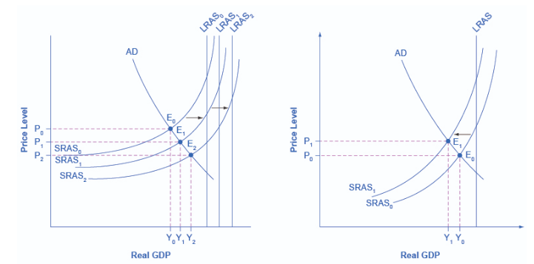
AS-AD Framework
(Source: Opentextbc.ca., 2022)
Notes:
In order to understand how GDP growth rate and AD-AS are linked together in explained in short with the diagram below. Productivity can be denoted as output generated produced utilising a certain amount of labour This output in economic terms is denoted by GDP. As productivity increases in due time, the output generated by utilising the same quantity of labour also increases. This increases the average supply (AS) along with GDP expansion (Bekaert, et al., 2020). Thus firms can produce more output at the same price level and at the same demand level. But as demand starts rising, the high input prices such as wages and power costs will discourage producers to supply more, as there is less possibility of earning profit. Consequently as supply decreases, the AS curve shift leftward and the GDP shrinks.

Slide 6
Monetary and fiscal policy
In terms of fiscal adjustment in wake of Covid pandemic, some of the measures of UK include the allocation of additional funding for NHS, public services, and small businesses. Increase in the social safety net to include vulnerable people. Additional job support scheme was also launched. A fiscal stimulus amounting to £59 billion was also announced. This kind of expansionary fiscal policy helps to increase spending by increasing the production/output (Policy Response to Covid 19., 2022).
Key monetary policy includes measures such as reduction in bank rate, and increased holding of government bonds. This leads to more money holding capacity by the general public (Calvert Jump and Kohler, 2020). Thus expansionary monetary policy helps to increase the money supply (Deleidi and Mazzucato, 2022). Increased money supply leads to increased spending. With more borrowing at a lesser rate from banks, manufacturers can bring down production prices and increase supply. This again leads to a GDP increase.

Slide 7
(ii) Inflation rate
Figure 2:………………………
(Source: CPIH INDEX, 2022)
Notes:
The financial crisis of 2008 led to sharp rise in CPI from 86.2 to 87.9 in 2010. The Eurozone crisis of 2010 to 2012 saw an even more increasing trend in CPI from 90.1 to 100.6 The period of the Brexit referendum from 2014 to 2017 saw a less steep rise from 99.6 to 103.6. While the Covid period saw an increase of 108.9 to 111.6.
Economic crises during these periods are always associated with rising inflation. As the economy of UK near its potential GDP and employment in a given year, the sudden rise in Aggregate demand pushes the demand curve to its right. This steep shift of demand curve towards right induces a likely increase in the price of things also. This causes price increase. This happens as the system reaches an equilibrium in demand supply curve (Caballero and Simsek, 2022). As UK manufacturers neared their potential full capacity of production in terms of labour and capital, so any increase in demand without an increase in supply will evidently push price up, causing inflation.

Slide 8
(iii) Unemployment rate
(Source: Unemployment rate, 2022)

Slide 9
The unemployment increase during the 2008 to 2010 financial crisis is highest compared to other phases. 2010 to 2012 witnessed a stable unemployment rate, while 2012 to 2019 saw a sharp decline in unemployment. Only from 2019 to 2021 witnessed a rise in Covid.
The graph shows mostly short term unemployment trends throughout the years. As GDP reached a full potential level, low cyclical unemployment occurred, as there is no increase in output even with more labour input. On the other when output generated was substantially less than the potential GDP, then high cyclical unemployment occurred in those years, especially during the financial recession phase of 2008-2010.
Monetary and fiscal policy
UK government provided increased job schemes to induct the extra labour force into the economy. Increased support for 80% of self-employed workers, paying £1,000 per employee till January end of 2021, supporting minimum wage for 25 hour/week for 6 months.

Slide 10
(iv) Exchange rate
(Source: Exchange rate, 2022)
Notes:
The exchange rate is steady for the whole period of 2008 to 2020 except for the year 2015 after the beginning of Brexit referendum.
The Brexit deal substantially weakened the sterling value against Euro. For this reason, prospective investors who were looking to invest in Euro in the UK in exchange for a larger sum of sterling/pound became disinterested (Balleer et al., 2020). This affected foreign investment prospects. Without the substantial foreign inflow of capital, new business development is slow and this is evidently affects the GDP.
Fiscal and monetary policy
UK developed its own tariff regime through UK Global Tariff, single-window trade opened to streamline control of import/export by commissioning £180 million for developmental purposes (Assets.publishing.service.gov.uk., 2022).

Slide 11
(v) Export growth
(Source: Total Trade- Exports. 2022)
Notes:
The above graph shows steady rise in total exports from 2008 to 2021. After the Brexit deal, between UK and the EU, the UK got an upper hand in developing its developing in own trade policies with other countries. This led to a substantial rise in new trade agreements and exports from 2016 onwards. This steep rise was cut short by Covid in 2020.
Increased exports will also increase aggregate demand and push the economy towards reaching the full level of output with more employment. Although this will also result in a slight increase in inflation.
Fiscal and monetary policy
Some of the initiatives taken by UK on account of its exit from the Brexit deal to increase exports are providing tax relief in 8 Freeports in England and more Freeports in Northern Ireland, Scotland and Wales. Revised Vat rates and established new trade and investment hubs (Assets.publishing.service.gov.uk., 2022).

Slide 12
3. Evaluation of the economic performance of Derbyshire
(i) Weekly earning and economic growth rate
(Source: Annual survey of hours and earnings, 2022)

Slide 13
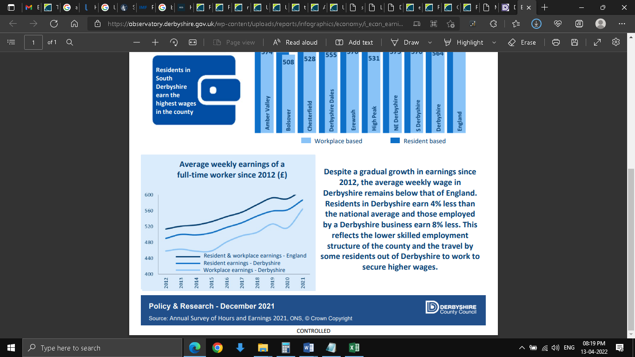
The weekly earnings comparison shows that Derbyshire is doing comparatively better in terms of growth rate from 2020 to 2021. Covid 19 left a deep impact in the weekly earnings of the UK in general but it was less evident in the case of Derbyshire.
(Source: Observatory.derbyshire.gov.uk. 2022)

Slide 14
Comparative economic growth of Derbyshire, UK and East Midland
(Source: Regional GDP, 2022)

Slide 15
(ii) Manufacturing output comparison
(Source: UK business: activity, size and location, 2022)

Slide 16
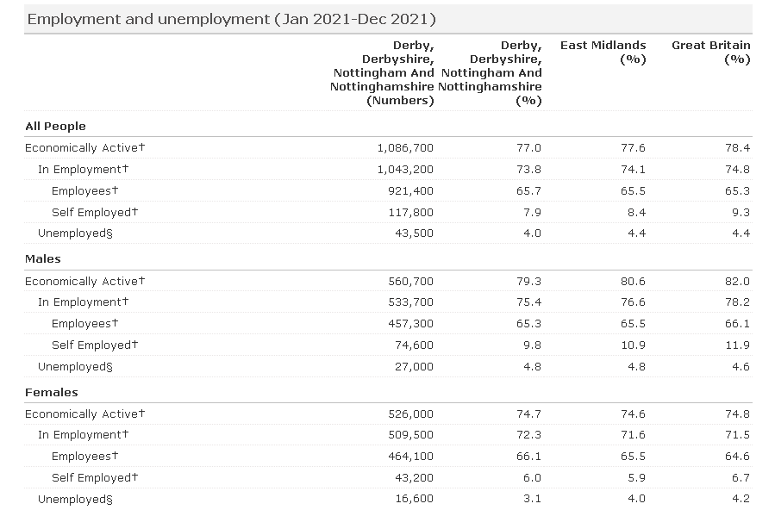
Unemployment in Derbyshire
Source: (Nomis Official Labour Statistics, 2022)
Notes:
The unemployment statistics of Derbyshire for the year 2021 indicate that out of a total of 77% of economically active people, 73.8% were employed while 4% were unemployed. Incidentally, the number of males unemployed was much higher than that of females. Total males unemployed stood at 27,000 and 16,600 respectively. These incidentally formed 4.8% and 3.1% of total unemployment in Derbyshire. In the context of East Midlands, this represented as 4.8% and 4.0% in males and females unemployment respectively.

Slide 17
Conclusion
The total manufacturing output contribution of Derbyshire needs to be increased. For this three things can be done, increase the business survivability chance in the long run close to that of England. Decrease the negative business growth rate in the core industries of Derbyshire. That is the industries that form the heartland of Derbyshire’s economic activity should be infused with necessary skilled labour. This will benefit not only the local ancillary business dependent on the core industries but also provide employment opportunities for local residents. They do not have to travel outside Derbyshire for higher packages. This will lead to savings on travel and accommodations. In order to create a pool of skilled employees from Derbyshire, government-sponsored technical and vocational courses can be conducted. Thus as local skilled employees start rising, more and more small scale ancillary industries can be set up gradually. This will not be a problem as the county already enjoys a higher than the national number of new business setups. Derbyshire can enter into cross border trade agreements with others such as Greater Manchester, West Yorkshire, South Yorkshire, Nottinghamshire and others for resource sharing in energy and natural resources. This way Derbyshire can tide over natural resources that are less available and open new industries.

Slide 18
Reference
Annual survey of hours and earnings. 2022. [online] Available at: <https://www.nomisweb.co.uk/datasets/ashe/view?geography=1807745081&time=2021,2020&item=1,2,3,4,5,6,7,8,9,10,11,12,13,14,15&rows=time&cols=item&tools=hidden> [Accessed 13 April 2022].
Assets.publishing.service.gov.uk. 2022. The Benefits of Brexit: How the UK is taking advantage of leaving the EU. [online] Available at: <https://assets.publishing.service.gov.uk/government/uploads/system/uploads/attachment_data/file/1054643/benefits-of-brexit.pdf> [Accessed 13 April 2022].
Balleer, A., Link, S., Menkhoff, M. and Zorn, P., 2020. Demand or supply? Price adjustment during the Covid-19 pandemic. [online] Available at: <https://www.econstor.eu/bitstream/10419/223466/1/cesifo1_wp8394.pdf> [Accessed 13 April 2022].
Bankofengland.co.uk. 2022. Monetary policy during pandemics. [online] Available at: <https://www.bankofengland.co.uk/-/media/boe/files/speech/2020/monetary-policy-during-pandemics.pdf?la=en&hash=FBE9F3BEFB5C224A3ECE2600431B97ECCD658B3B> [Accessed 13 April 2022].
Bekaert, G., Engstrom, E. and Ermolov, A., 2020. Aggregate demand and aggregate supply effects of covid-19: A real-time analysis. Available at SSRN 3611399. [online] Available at: <https://www.federalreserve.gov/econres/feds/files/2020049pap.pdf> [Accessed 13 April 2022].
Caballero, R.J. and Simsek, A., 2022. A note on temporary supply shocks with aggregate demand inertia (No. w29815). National Bureau of Economic Research. [online] Available at: <https://www.nber.org/system/files/working_papers/w29815/w29815.pdf> [Accessed 13 April 2022].
Calvert Jump, R. and Kohler, K., 2020. A History of Aggregate Demand and Supply Shocks for the United Kingdom, 1900 to 2016. Available at SSRN 3725609. [online] Available at: < https://papers.ssrn.com/sol3/papers.cfm?abstract_id=3725609> [Accessed 13 April 2022].
CPIH INDEX. 2022. UK National Statistics. 2022. [online] Available at: <https://www.ons.gov.uk/economy/inflationandpriceindices/timeseries/l522/mm23> [Accessed 13 April 2022].
Deleidi, D. and Mazzucato, P., 2022. Post-2008 UK monetary policy. [online] Ucl.ac.uk. Available at: <https://www.ucl.ac.uk/bartlett/public-purpose/sites/public-purpose/files/iipp-pb-03-qe-16-08-2018.pdf> [Accessed 13 April 2022].
Derbyshire Observatory. 2022 – Businesses. [online] Available at: <https://observatory.derbyshire.gov.uk/businesses/> [Accessed 13 April 2022].
Exchange rate. 2022. UK National Statistics. [online] Available at: <https://www.ons.gov.uk/economy/nationalaccounts/balanceofpayments/timeseries/thap/diop> [Accessed 13 April 2022].
Nomis Official Labour Statistics. 2022. Labour Market Profile. [online] Available at: <https://www.nomisweb.co.uk/reports/lmp/lep/1925185580/report.aspx#tabrespop> [Accessed 13 April 2022].
Observatory.derbyshire.gov.uk. 2022. Business size/sector in Derbyshire. [online] Available at: <https://observatory.derbyshire.gov.uk/wp-content/uploads/reports/infographics/economy/i_econ_business_size_sector.pdf> [Accessed 13 April 2022].
Observatory.derbyshire.gov.uk. 2022. Earnings in Derbyshire. [online] Available at: <https://observatory.derbyshire.gov.uk/wp-content/uploads/reports/infographics/economy/i_econ_earnings.pdf> [Accessed 13 April 2022].
Opentextbc.ca. 2022. Principles of Economics. [online] Available at: <https://opentextbc.ca/principlesofeconomics/chapter/24-3-shifts-in-aggregate-supply/#CNX_Econ_C24_013> [Accessed 13 April 2022].
Policy Response to Covid 19. 2022. [online] Available at: <https://www.imf.org/en/Topics/imf-and-covid19/Policy-Responses-to-COVID-19#V> [Accessed 13 April 2022].
Regional GDP. 2022. UK National Statistics. [online] Available at: <https://www.ons.gov.uk/economy/grossdomesticproductgdp/datasets/regionalgrossdomesticproductlocalauthorities> [Accessed 13 April 2022].
Total Trade- Exports. 2022. UK National Statistics. [online] Available at: <https://www.ons.gov.uk/economy/nationalaccounts/balanceofpayments/timeseries/ikbh/pnbp> [Accessed 13 April 2022].
UK business: activity, size and location. 2022. UK National Statistics. [online] Available at: <https://www.ons.gov.uk/businessindustryandtrade/business/activitysizeandlocation/datasets/ukbusinessactivitysizeandlocation> [Accessed 13 April 2022].
UK GDP 2022. UK National Statistics. [online] Available at: <https://www.ons.gov.uk/economy/grossdomesticproductgdp/timeseries/ybha/ukea> [Accessed 13 April 2022].
Unemployment rate. 2022. UK National Statistics. [online] Available at: <https://www.ons.gov.uk/employmentandlabourmarket/peoplenotinwork/unemployment/timeseries/mgsx/lms> [Accessed 13 April 2022].

